Slide 1
Web Scrapper Web Apps for gathering web contents
Start 27-Nov-2021 @ 10:24 am
End 27-Nov-2021 @ 10:24 am
x
Tasks
1
Purpose
Users/Admin
1
Purpose
2
Target
3
Workflow
4
Features
Scheduler
2
Target
1
Crawl designated sites for URL
1
Local Banks Exchange rates
1
Overall design for application
1
Modular and Script based
2
Scrape URL for designated contents
2
Bank Negara Malaysia Gold
2
Include high-level functions
2
Manual and automate tracking
User Interface
3
Workflow
1
Overview
3
Google search for crawling
3
Craw and scrapes with scripts
2
Functions
4
News and articles from the web
User/ Admin
WebApps Security
Tracer Logs
4
Automated alerts and notifications
4
Features
5
Personal medical records
5
Dashboard and reports
Web APPS
2
To support Multihost capability
API
Store collections into database
Display options
Auto Option
Manual
option
Select Views
Option
Scheduler
Alerts/Notifications
User/ Admin
Scrape contents
Process message
View Contents
Select Script
Scripts Library
Parser
SMS
Emails
Social Media
Scrappers
Crawlers
Extractor Format
Extractor Format

Slide 2

Web Scrapper Web Apps for gathering web contents
Start 27-Nov-2021 @ 10:24 am
End 27-Nov-2021 @ 10:24 am
x
Tasks
1
Purpose
Users/Admin
1
Purpose
2
Target
3
Workflow
4
Features
Scheduler
2
Target
1
Crawl designated sites for URL
1
Local Banks Exchange rates
1
Overall design for application
1
Modular and Script based
2
Scrape URL for designated contents
2
Bank Negara Malaysia Gold
2
Include high-level functions
2
Manual and automate tracking
User Interface
3
Workflow
1
Overview
3
Google search for crawling
3
Craw and scrapes with scripts
2
Functions
4
News and articles from the web
User/ Admin
WebApps Security
Tracer Logs
4
Automated alerts and notifications
4
Features
5
Personal medical records
5
Dashboard and reports
Web APPS
2
To support Multihost capability
API
Store collections into database
Display options
Auto Option
Manual
option
Select Views
Option
Scheduler
Alerts/Notifications
User/ Admin
Scrape contents
Process message
View Contents
Select Script
Scripts Library
Parser
SMS
Emails
Social Media
Scrappers
Crawlers
Extractor Format
Extractor Format

Slide 3
Web Scrapper Web Apps eco-systems and design
Start 27-Nov-2021 @ 10:24 am
End 27-Nov-2021 @ 10:24 am

Slide 4
Web Scrapper Web Apps eco-systems and design
Start 27-Nov-2021 @ 10:24 am
End 27-Nov-2021 @ 10:24 am
x
Tasks
1
Purpose
1
Purpose
2
Target
3
Workflow
4
Features
2
Target
1
Crawl designated sites for URL
1
Local Banks Exchange rates
1
Overall design for application
1
Modular and Script based
3
Workflow
2
Scrape URL for designated contents
2
Bank Negara Malaysia Gold
2
Include high-level functions
2
Manual and automate tracking
1
Overview
3
Google search for crawling
3
Craw and scrapes with scripts
2
Functions
4
News and articles from the web
4
Automated alerts and notifications
4
Features
5
Personal medical records
5
Dashboard and reports

Slide 5


Slide 6


Slide 7

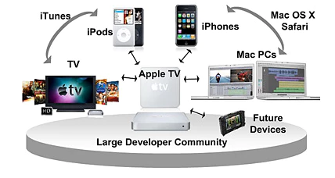
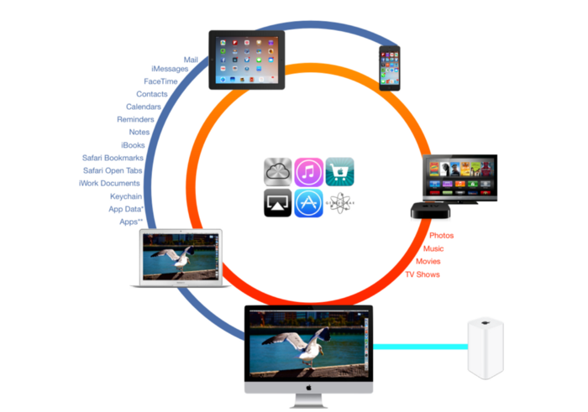
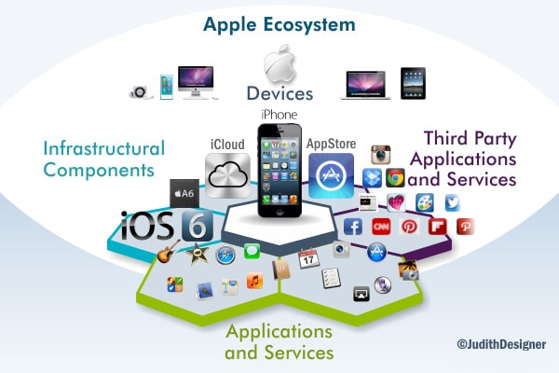

Slide 9


Slide 10
















